Slide 1
MIPS Verilog
Octavian Coste

Slide 2
Requirements
MIPS(microprocessor without pipeline) – single cycle microarchitecture
Compilator

Slide 3
MIPS
Modul MIPS
PC
Adder
Instruction Memory
Shift Left 2
Control
Registers
Mux
Sign Extend
ALU control
ALU
And
Data Memory
clock
reset

Slide 4
Operatii
Add - addition
Sw – store word
Lw – load word
Addi – add immediate
Beq – branch or equal
J - jump
And
or
Sub - subtract
slt - set or less than

Slide 5
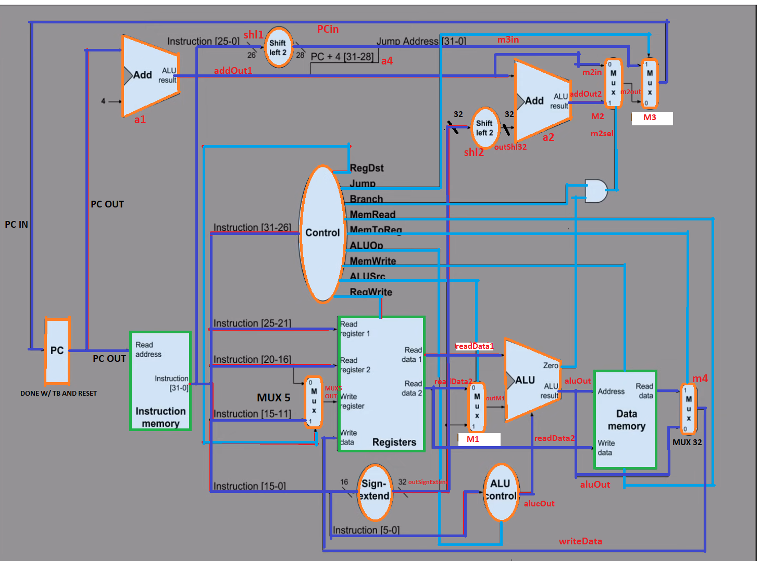
Memory
Results
MIPS
Operatii

Slide 6
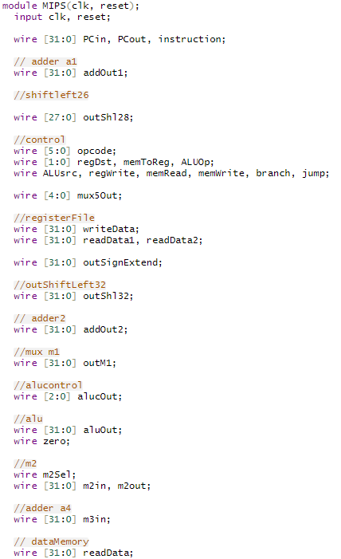
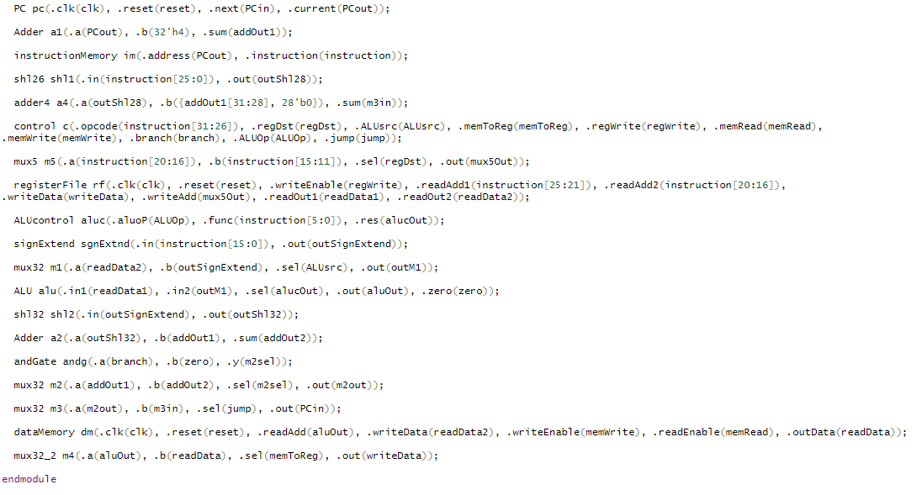
Modul MIPS

Slide 7


And

Slide 8
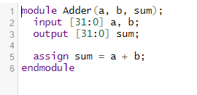
Adder

Slide 9
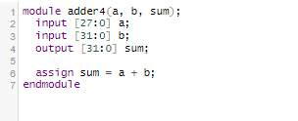
Adder4

Slide 10
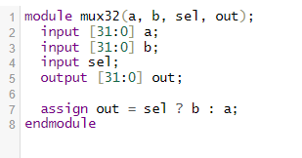
Mux32

Slide 11
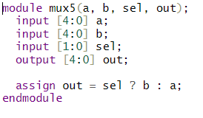
Mux5

Slide 12
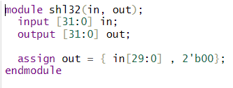
Shift Left 32

Slide 13
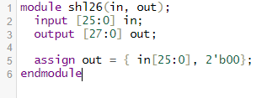
Shift Left 26

Slide 14
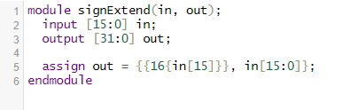
Sign Extend

Slide 15
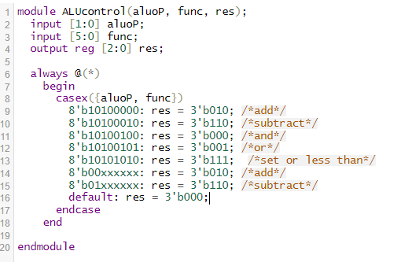
ALU Control

Slide 16
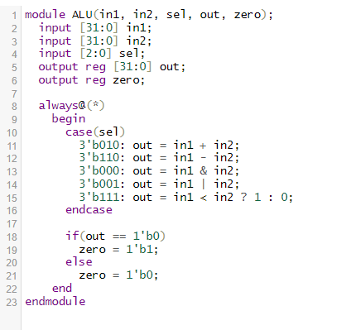
ALU

Slide 17
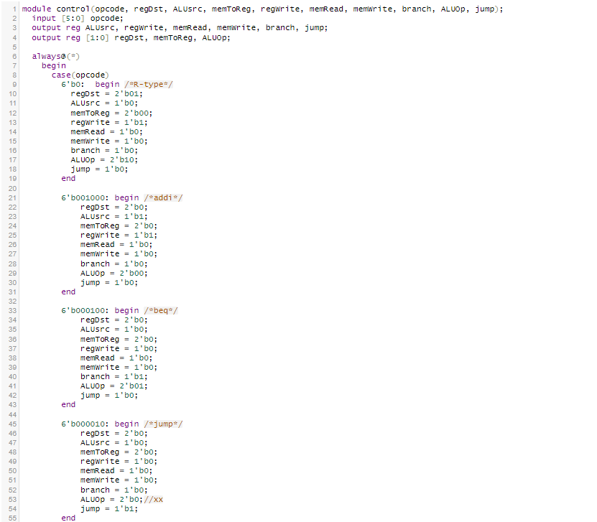
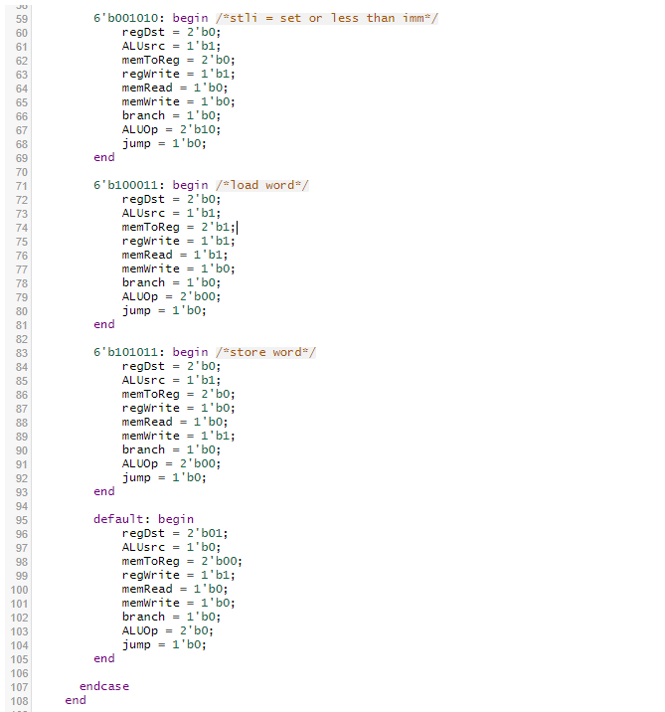
Control

Slide 18
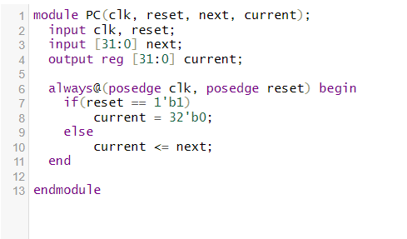
PC

Slide 19
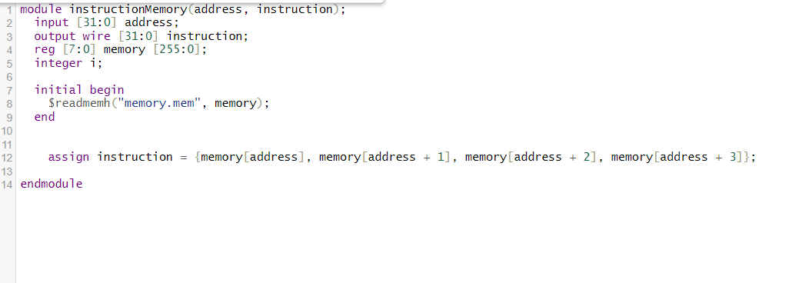
Instruction memory

Slide 20
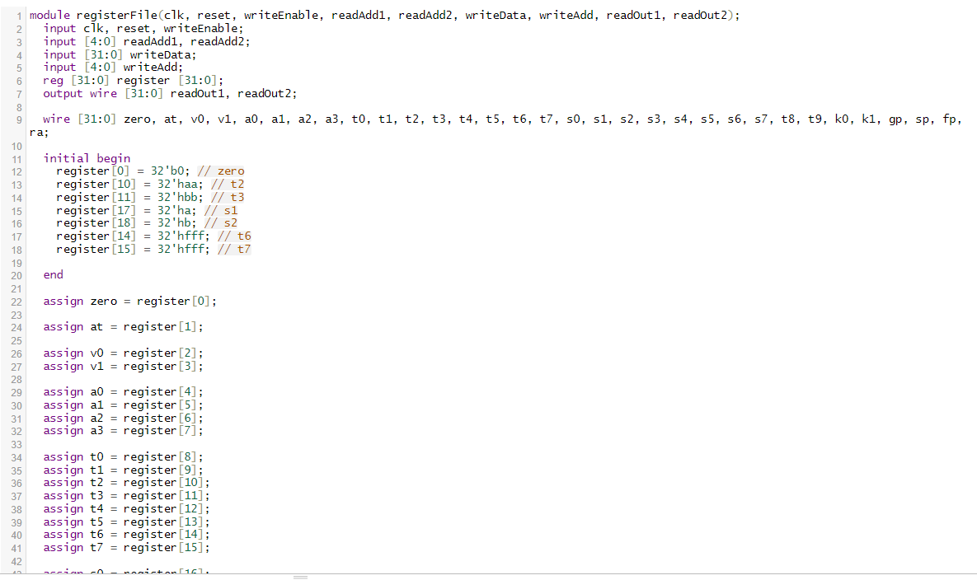
Registers

Slide 21
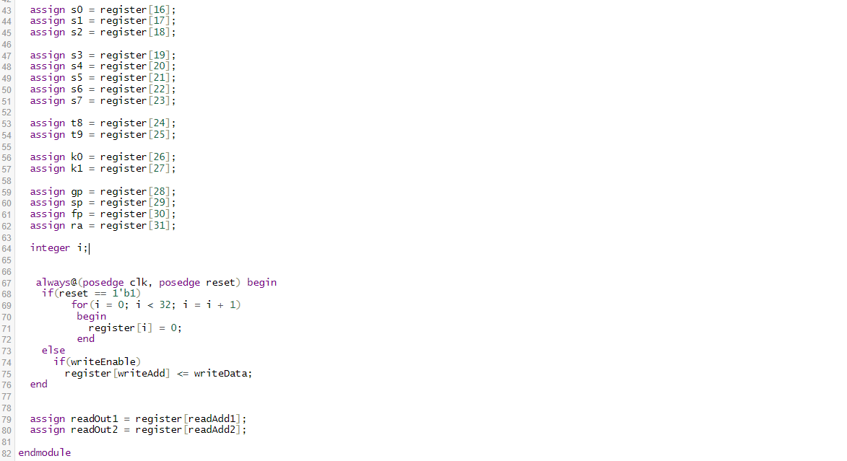
Registers

Slide 22
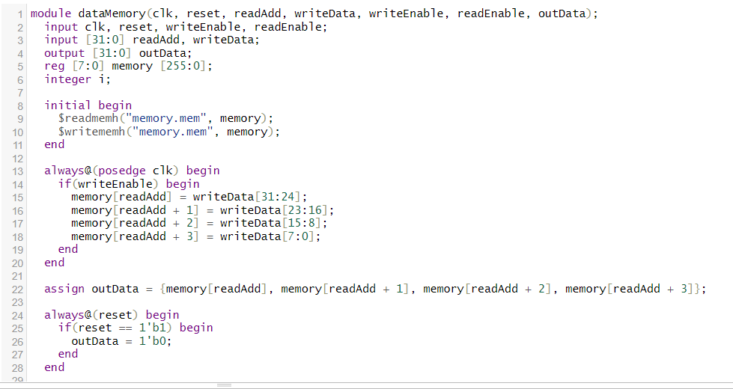
Data Memory

Slide 23
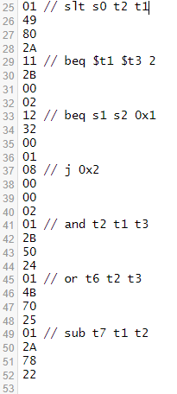
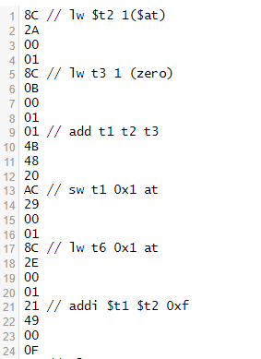
Memory

Slide 24
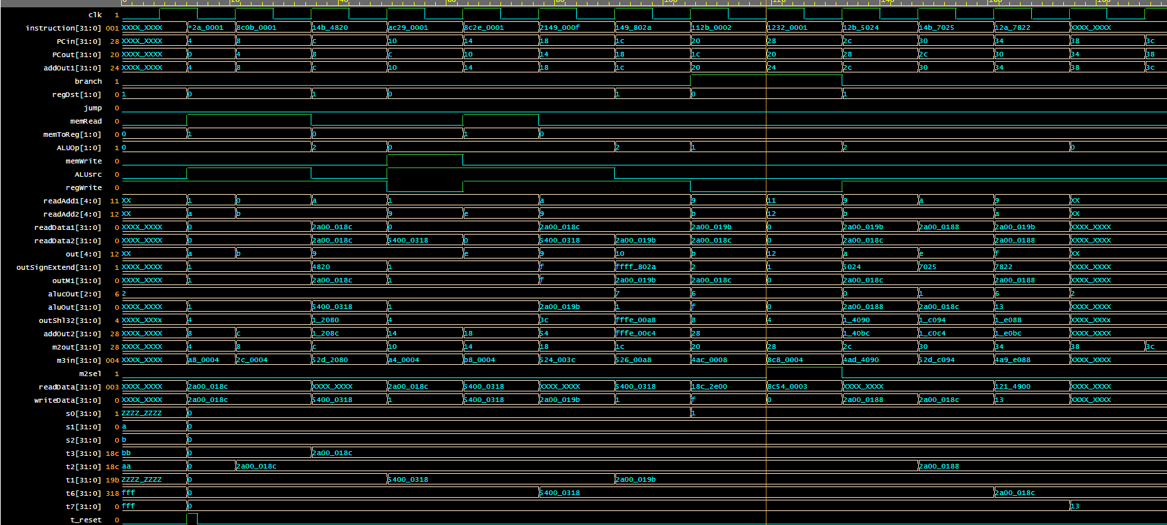

Results
m5

Slide 25
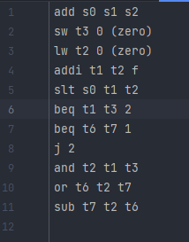
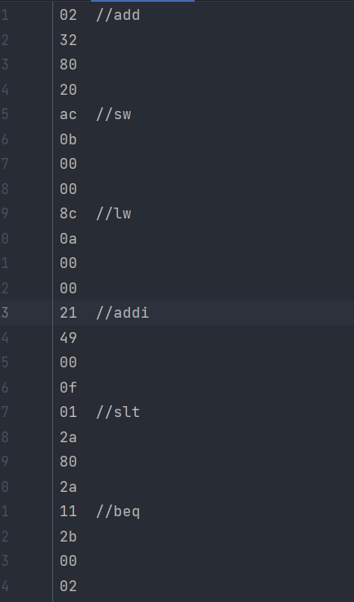

Compilator
Instructiune ASM
Numar hexadecimal pe 32 de biti

Slide 26
.
Compiler
Dictionare
Functii
Main

Slide 27
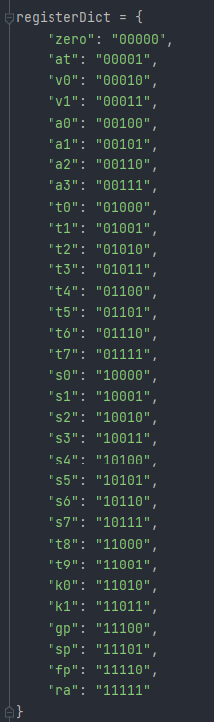
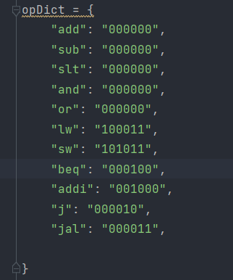
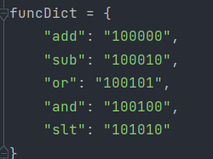
Dictionare
add s0 s1 s2
s1 s2 s0
00000010001100101000000000100000

Slide 28
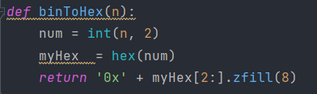


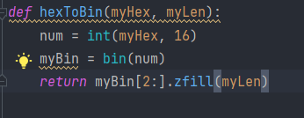
Functii

Slide 29
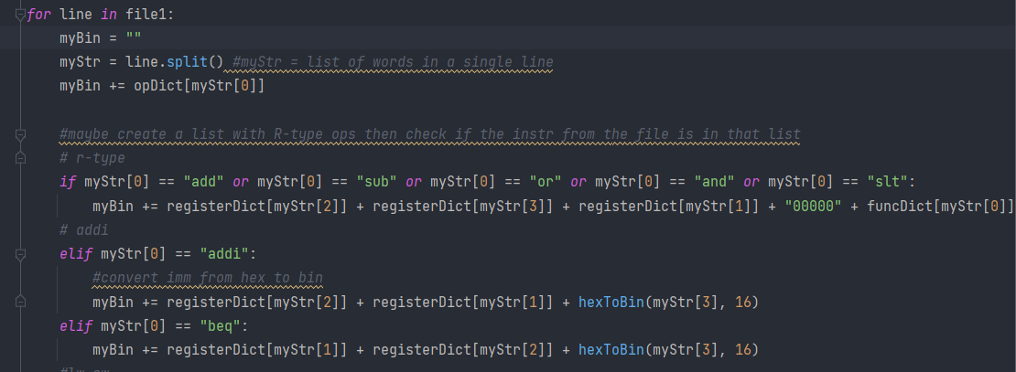




Main
myStr = [add, t1, t2, t3]
myBin = 00000001010010110100100000100000

Slide 30
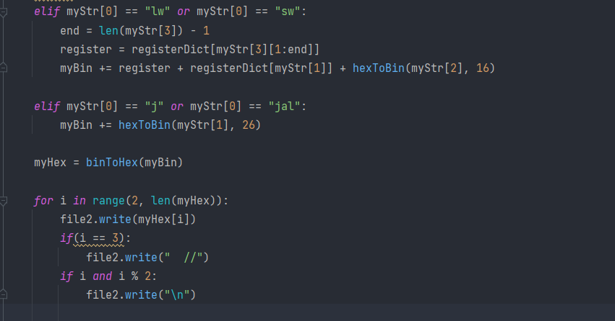
Main
j 0X2
01
4b
48
20
myBin = 00000001010010110100100000100000
myHex = 0x014b4820

Slide 31
Mulțumesc pentru atenție!

